Slide 1
Hiya Guard AI
By Mohammed Zakriah Ibrahim

Slide 2
Customer Scenario and Rationale
About the Product
Real-time voice AI that answers unknown calls, detects spam/scam, and schedules legitimate callbacks.
Customer Scenario
Busy professional receives unknown call → AI engages first, detects intent, and either schedules callback or declines.
Rationale/Impact
Save time • Protect privacy • Boost productivity • Extends Hiya’s mission of trusted voice.

Slide 3
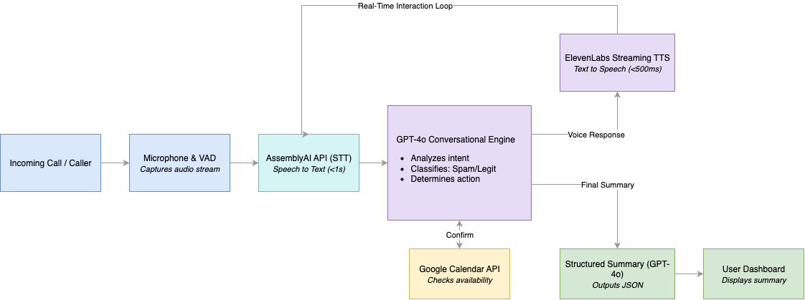
Technical Architecture & System Flow
Audio I/O + VAD (Voice Activity Detection)
LLM Intent Engine
Streaming TTS
Calendar Tool Call
Summary Engine

Slide 4
Technology Choices & Orchestration
Layer
Technology
Reason
Language/Runtime
Python 3.11 + AsyncIO
Concurrent WebSockets and for rapid prototyping
Speech to Text
Assembly AI (via Webhook for Streaming)
Accurate transcription with minimal latency
LLM
GPT-4o
Contextual intent reasoning and structured outputs
Text to Speech
ElevenLabs (external API)
Human-like voice and quick voice synthesis
Tool Call
Google Calendar API for scheduling
Real callback scheduling
Framework
aiohttp + Async event loop
Parallel STT↔LLM↔TTS for <2.5 s end-to-end

Slide 5
Outcomes & Challenges Overcome
Achievements: End-to-end STT→LLM→TTS; Google Calendar callbacks; sub-2.5 s latency; >90% spam detection; structured summary
Latency Optimization: streaming audio, greeting caching, parallel init
Security: OAuth 2.0, env-based secrets, no persistent call content
Audio Quality: VAD, echo-reduction via headphone routing
Robustness: retry logic, graceful degradation, WebSocket reconnection

Slide 6
Potential Next Steps
Integration Enhancements
Twilio integration: Connect to real phone systems
CRM integration: Sync with Salesforce, HubSpot, etc.
Slack/Teams Notifications: Real-time call alerts
Database Storage: Persistent call history and analytics
Enhanced Features
Multi-language Support: Detect and respond in caller's language
Voice Cloning: Custom voice training for personalized responses
Sentiment Analysis: Detect caller emotional state and adjust responses
Context Memory: Remember previous interactions with callers

